Slide 1
What is Data?
Nicholas Mattei, Tulane University
CMPS3660 – Introduction to Data Science – Fall 2019
https://rebrand.ly/TUDataScience
Many Thanks
Slides based off Introduction to Data Science from John P. Dickerson - https://cmsc320.github.io/
Some examples taken from Data Science by John D. Kelleher and Brendan Tierney, MIT Press.

Slide 2
Announcements
No office hours this Thursday!
Lab day moved to Tuesday 9/10
Make sure you can run Docker or Anaconda on your laptop.
Note that you can develop on either Docker, Anaconda, System Python… but it must run on Docker for grading.
Regraded Quiz 1 for some of you … reminder that it’s due tonight.
Email Policy: I will turn around email in 24 hours – but I don’t necessarily work on the weekends either.

Slide 3
The Data LifeCycle
Today
Data Collection
Data Processing
Exploratory Analysis
&
Data Visualization
Analysis, Hypothesis Testing,
& ML
Insight
&
Policy Decision

Slide 4
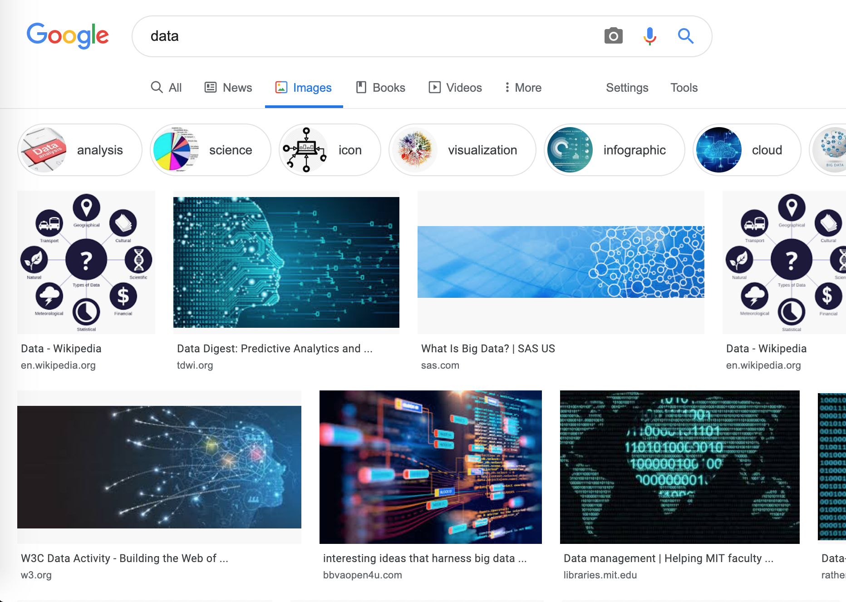
What is Data?
I’m going to give you a classical “statistical” overview of tabular data.
As we go on I’ll ask you think think more liberally about data but we gotta know our fundamentals first!

Slide 5
Tabular Data
Data is an abstraction of some real world entity.
Sometimes also called: instance, example, record, object, case, individual.
Each of these entities is described by a set of features.
Sometimes you’ll see these called variables, features, attributes,
Data like this is typically processed into an n (number of entities) by m (number of attributes) matrix.
Typically the result of merging and processing many different records!
Picking the data that goes into this table has both technical and ethical concerns (recall our examples of Target, Netflix…).
Data Collection
Data Processing
ID | Title | Author | Year | Cover | Edition | Price
1 | Emma | Austen | 1815 | Paper | 20th | $5.75
2 | Dracula | Stoker | 1897 | Hard | 15th | $12.00
3 | Ivanhoe | Scott | 1820 | Hard | 8th | $25.00
4 | Kidnapped | Stevenson | 1886 | Paper | 11th | $5.00

Slide 6
Classical Statistical Idea of Data
Data Types
Categorical
Numerical
Interval
Ratio
Nominal
Ordinal
There are four classical types of data

Slide 7


Categorical Data – Takes a Value From a Finite Set
Nominal (Categorical) Data.
Values have names – describe the categories, classes, or states of things.
Marital status, beer type, or some binary attribute.
Cannot compare the values, hence we cannot naturally order them and we cannot use arithmetic on them.
Ordinal Data.
Values have names – describe the categories, classes, or states of things.
However, there is an ordering over the values:
Strongly like, like, neutral, strongly dislike.
Lacks a mathematical notion of distance between the values.
This distinction can be blurry…
Is there an ordering over: sunny, overcast, rainy?

Slide 8

Numerical Data - Measured Using Integers or Real Quantities.
Interval Scale.
Scale with fixed but arbitrary interval (e.g., dates).
The difference between two values is meaningful:
Difference between 9/1/2019 and 10/1/2019 is the same as the difference between 9/1/2018 and 9/1/2019.
However: we cannot compute ratios or scales: what unit is 9/1/2019 * 9/1/2018?
Ratio Scale
All of the same properties as an inverval scale data, but the scale of measurement possesses a true-zero origin.
Can look at the ratio between two quantities (unlike an interval scale).
E.g., zero money is an absolute, one money is half as much as two money… etc.

Slide 9

Numerical Data - Examples
Temperatures:
Celsius / Fahrenheit: interval or ratio scale ?????
Interval: 0C or 0F is not 0 heat but rather an arbitrary fixed point.
Hence, we can’t say that 30F is twice as warm as 15F.
Kelvin (K): interval or ratio scale ????
Ratio: 0k is defined as zero heat (no molecular motion) hence a true fixed point.
Weight:
Grams: interval or ratio scale ?????
Ratio: 0g serves as a fixed point, 4g is 2x 2g.

Slide 10
General Rules
OK to compute.... | Nominal | Ordinal | Interval | Ratio
frequency distribution | Yes | Yes | Yes | Yes
median and percentiles | No | Yes | Yes | Yes
add or subtract | No | No | Yes | Yes
mean, standard deviation, standard error of the mean | No | No | Yes | Yes
ratio, or coefficient of variation | No | No | No | Yes
?
?
?
?
Thanks to GraphPad

Slide 11
General Rules
OK to compute.... | Nominal | Ordinal | Interval | Ratio
frequency distribution | Yes | Yes | Yes | Yes
median and percentiles | No | Yes | Yes | Yes
add or subtract | No | No | Yes | Yes
mean, standard deviation, standard error of the mean | No | No | Yes | Yes
ratio, or coefficient of variation | No | No | No | Yes
?
?
?
?

Slide 12
General Rules
OK to compute.... | Nominal | Ordinal | Interval | Ratio
frequency distribution | Yes | Yes | Yes | Yes
median and percentiles | No | Yes | Yes | Yes
addition or subtraction | No | No | Yes | Yes
mean, standard deviation, standard error of the mean | No | No | Yes | Yes
ratio, or coefficient of variation | No | No | No | Yes
?
?
?
?

Slide 13
General Rules
OK to compute.... | Nominal | Ordinal | Interval | Ratio
frequency distribution | Yes | Yes | Yes | Yes
median and percentiles | No | Yes | Yes | Yes
addition or subtraction | No | No | Yes | Yes
mean or standard deviation | No | No | Yes | Yes
ratio, or coefficient of variation | No | No | No | Yes
?
?
?
?

Slide 14
General Rules
OK to compute.... | Nominal | Ordinal | Interval | Ratio
frequency distribution | Yes | Yes | Yes | Yes
median and percentiles | No | Yes | Yes | Yes
addition or subtraction | No | No | Yes | Yes
mean or standard deviation | No | No | Yes | Yes
ratio, or coefficient of variation | No | No | No | Yes
?
?
?
?
Notes:
Coefficient of variation aka “relative standard deviation” – generally the ratio of the standard deviation to the mean of the sample – 0% = point (stdev 0 divided by mean), higher is more variable

Slide 15
General Rules
OK to compute.... | Nominal | Ordinal | Interval | Ratio
frequency distribution | Yes | Yes | Yes | Yes
median and percentiles | No | Yes | Yes | Yes
addition or subtraction | No | No | Yes | Yes
mean or standard deviation | No | No | Yes | Yes
ratio, or coefficient of variation | No | No | No | Yes
Notes:
Coefficient of variation aka “relative standard deviation” – generally the ratio of the standard deviation to the mean of the sample – 0% = point (stdev 0 divided by mean), higher is more variable
In finance, the coefficient of variation allows investors to determine how much volatility, or risk, is assumed in comparison to the amount of return expected from investments.

Slide 16
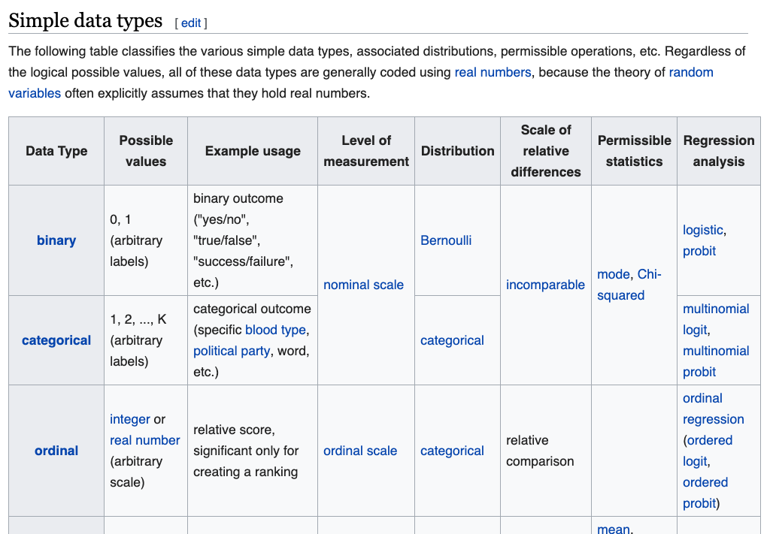
Lots of fine grained rules…
Nominal Data:
Frequencies, proportions, and percentages.. Histograms… etc.
Continuous Data:
Also get to use standard deviation, mean, etc.
Nice Summary: https://en.wikipedia.org/wiki/Statistical_data_type
We’ll discuss more as we get into the data!

Slide 17
A Take Home Point About Data Ethics
Always remember that data is generated by abstraction.
Someone picked what data to look at, how to count things, and what not to count.
How could this lead to problems?
What about when it changes?
However, we can still do useful things
“A map is not the territory that it represents, but, if correct, it has a similar structure to the territory which accounts for its usefulness” -- Alfred Korzybski, Science and Sanity
Never forget that there is no such thing as “raw data” and that data is never a purely objective description of the world.
Notes:
GDP
Race
National orgin/

Slide 18
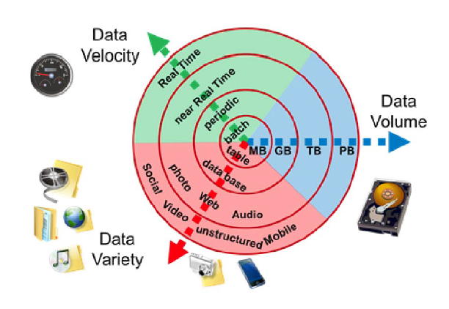
Data Manipulation and Computation
Data Science == manipulating and computing on data
Large to very large, but somewhat “structured” data
Wait, what about BIG DATA?
Volume: The quantity of generated and stored data. The size determines the value and potential insight.
Variety: The type and nature of the data. Big data draws from text, images, audio, video; plus it completes missing pieces through data fusion.
Velocity: The speed at which the data is generated and processed. Big data is often available in real-time.
Compared to small data, big data are produced more continually. Two kinds of velocity related to big data are the frequency of generation and the frequency of handling, recording, and publishing.
Sometimes Veracity but we won’t consider this..

Slide 19
Data Manipulation and Computation
Data Science == manipulating and computing on data
Large to very large, but somewhat “structured” data
We will see several tools for doing that this semester
Thousands more out there that we won’t cover
Need to learn to shift thinking from:
Imperative code to manipulate data structures
to:
Sequences/pipelines of operations on data
Should still know how to implement the operations themselves, especially for debugging performance (covered in classes like Machine Learning), but we won’t cover that much formal algorithmic treatment.

Slide 20
Data Manipulation and Computation
Data Representation == what is the natural way to think about given data
Data Processing Operations == take one or more datasets as input and produce one or more datasets as output
Indexing
Slicing/subsetting
Filter
‘map’ → apply a function to every element
’reduce/aggregate’ → combine values to get a single scalar (e.g., sum, median)
Given two vectors: Dot and cross products
One-dimensional Arrays, Vectors
0.1 | 2 | 3.2 | 6.5 | 3.4 | 4.1
“data” | ”representation” | ”i.e.”

Slide 21
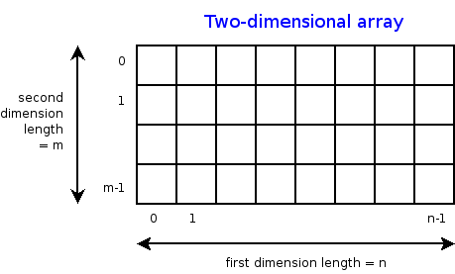
Data Manipulation and Computation
Data Representation == what is the natural way to think about given data
Data Processing Operations == take one or more datasets as input and produce one or more datasets as output
n-dimensional arrays
Indexing
Slicing/subsetting
Filter
‘map’ → apply a function to every element
’reduce/aggregate’ → combine values across a row or a column (e.g., sum, average, median etc..)

Slide 22
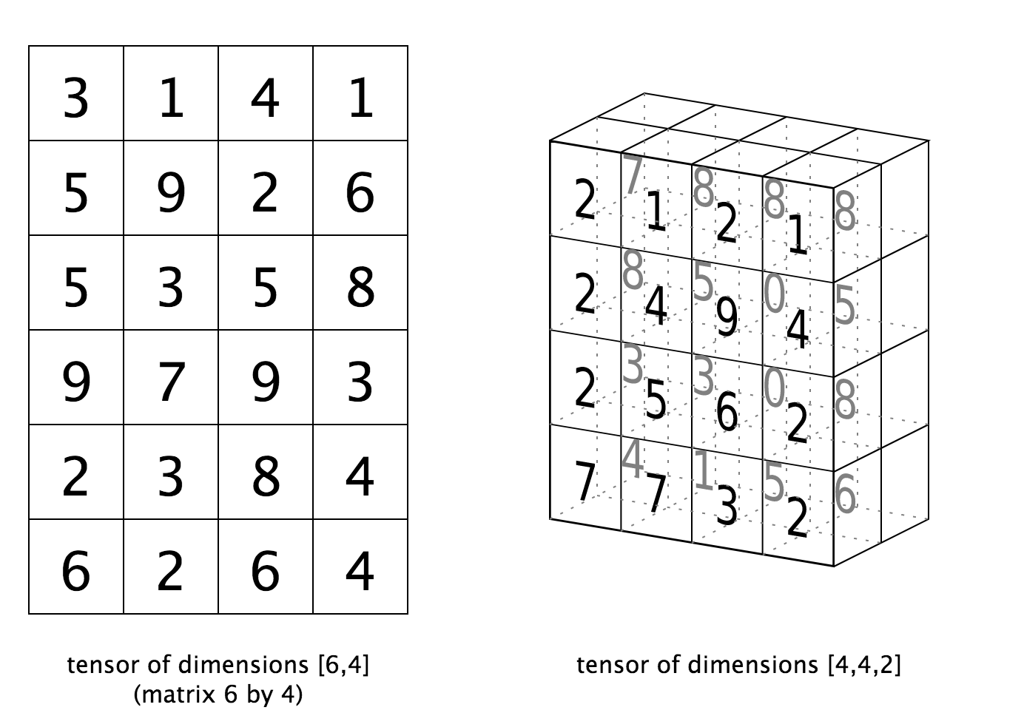
Data Manipulation and Computation
Data Representation == what is the natural way to think about given data
Data Processing Operations == take one or more datasets as input and produce one or more datasets as output
Matrices, Tensors
n-dimensional array operations
+
Linear Algebra
Matrix/tensor multiplication
Transpose
Matrix-vector multiplication
Matrix factorization

Slide 23
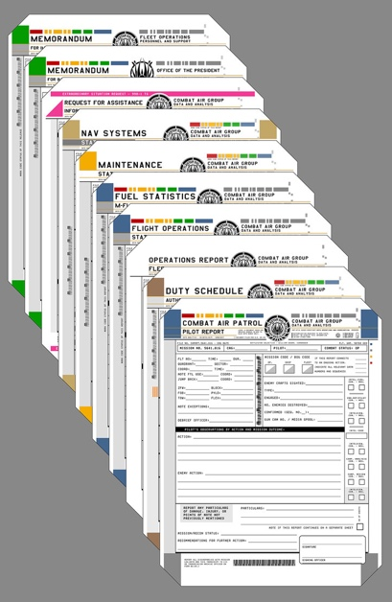
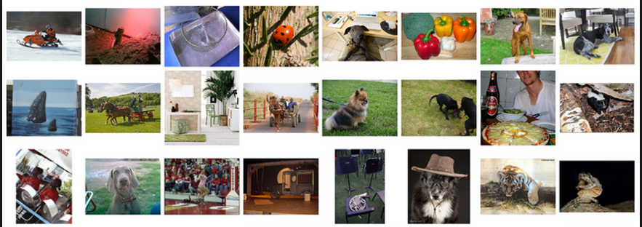
Data Manipulation and Computation
Data Representation == what is the natural way to think about given data
Data Processing Operations == take one or more datasets as input and produce one or more datasets as output
Filter
Map
Union
Reduce/Aggregate
Given two sets, Combine/Join using “keys”
Group and then aggregate
Sets: of Objects
Sets: of (Key, Value Pairs)
(cs@tulane,(email1, email2,…))
(nsmattei@tulane.edu,(email3, email4,…))

Slide 24
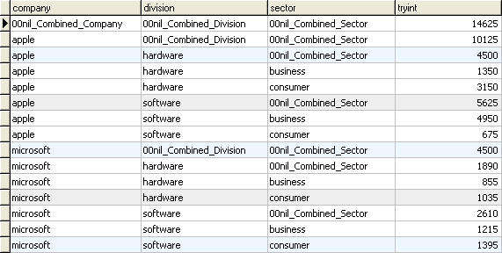
Data Manipulation and Computation
Data Representation == what is the natural way to think about given data
Data Processing Operations == take one or more datasets as input and produce one or more datasets as output
Filter rows or columns
”Join” two or more relations
”Group” and “aggregate” them
Relational Algebra formalizes some of them
Structured Query Language (SQL)
Many other languages and constructs, that look very similar
Tables/Relations == Sets of Tuples

Slide 25
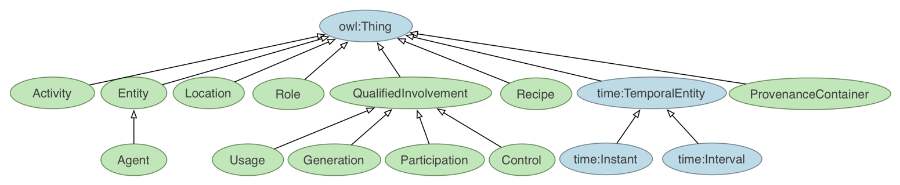
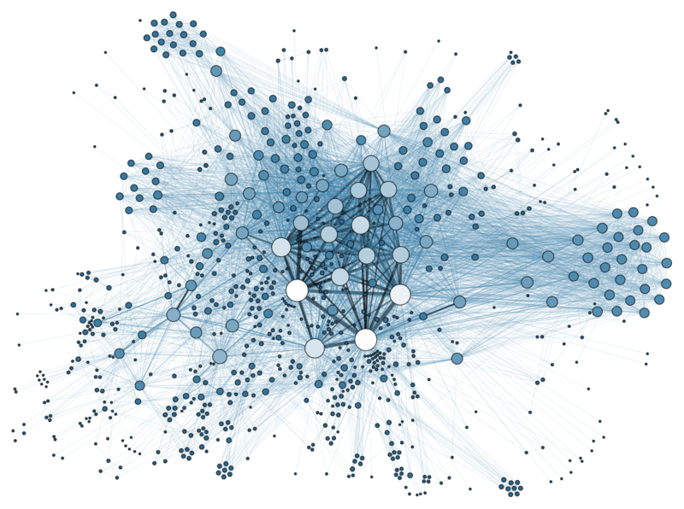
Data Manipulation and Computation
Data Representation == what is the natural way to think about given data
Data Processing Operations == take one or more datasets as input and produce one or more datasets as output
Hierarchies/Trees/Graphs
”Path” queries
Graph Algorithms and Transformations
Network Science
Somewhat more ad hoc and special-purpose
Changing in recent years

Slide 26
Data Manipulation and Computation
Data Representation == what is the natural way to think about given data.
Data Processing Operations == take one or more datasets as input and produce one or more datasets as output.
Why?
Allows one to think at a higher level of abstraction, leading to simpler and easier-to-understand scripts.
Provides ”independence” between the abstract operations and concrete implementation.
Can switch from one implementation to another easily.
For performance debugging, useful to know how they are implemented and rough characteristics
Let’s go work on some code!

Slide 27
Next Few Classes
NumPy: Python Library for Manipulating nD Arrays
Multidimensional Arrays, and a variety of operations including Linear Algebra
Pandas: Python Library for Manipulating Tabular Data
Series, Tables (also called DataFrames)
Many operations to manipulate and combine tables/series
Relational Databases
Tables/Relations, and SQL (similar to Pandas operations)
Other tools like Git and Docker!

